Slide 1

“SENTIMENT ANALYSIS”
Project Progress Report
Submitted
In partial fulfillment for the award of the degree of
BACHELOR OF TECHNOLOGY
In
COMPUTER SCIENCE AND ENGINEERING
Submitted By
Komal Singh(1904230100026)
Nazeem Ahmad(1904230100036)
Under the supervision of
Niyati Gaur
(Assistant Professor)
SCHOOL OF MANAGEMENT SCIENCES, LUCKNOW
(Affiliated to Dr. A.P.J Abdul Kalam Technical University, Lucknow (UP)
March , 2023

Slide 2
Contents
Introduction
Hardware/ Software Requirements
Projects Design
DFD
ER Diagram / Use Case Diagram
Project Progress
GANTT Chart
Activity Diagram
Estimated time to complete the project
Project Screen Shots
Future Scope
Conclusion
Publications
References

Slide 3
Introduction
Fit Buddy is an android app which can help users in achieving their fitness goals.
It contains various modules to guide users and motivates them for a healthy & fit lifestyle.
It’s a task based fitness app which collects some data related to the user and gives them tasks to perform according to their fitness goals.
It provides Custom Diet Chart , Custom workout plan, notification reminder for better growth.

Slide 4
Hardware/ Software Requirements
Software Requirements
Android Version > V4.4
Android emulator (Bluestacks)
Hardware Requirements
Chipset supporting android/ Linux architecture.
Ram >2GB
Max. 500 mb free storage

Slide 5
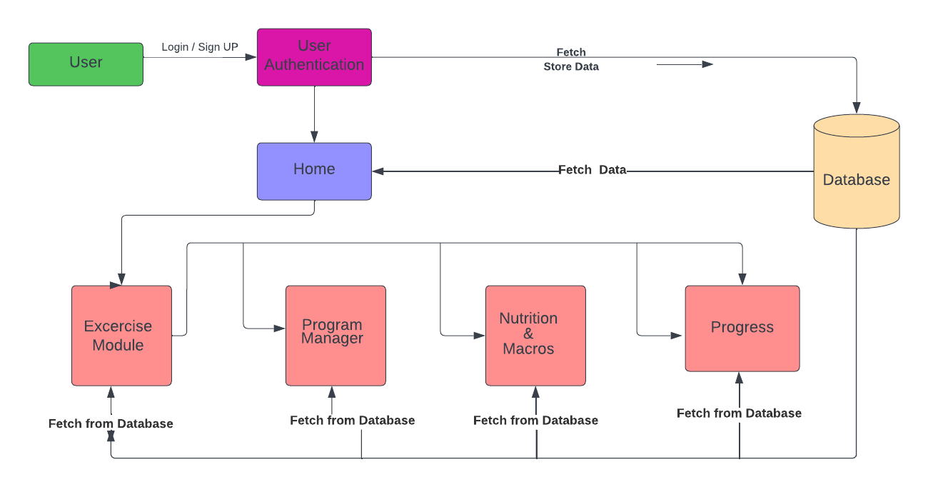
Projects Design
Project Modules
DFD:

Slide 6
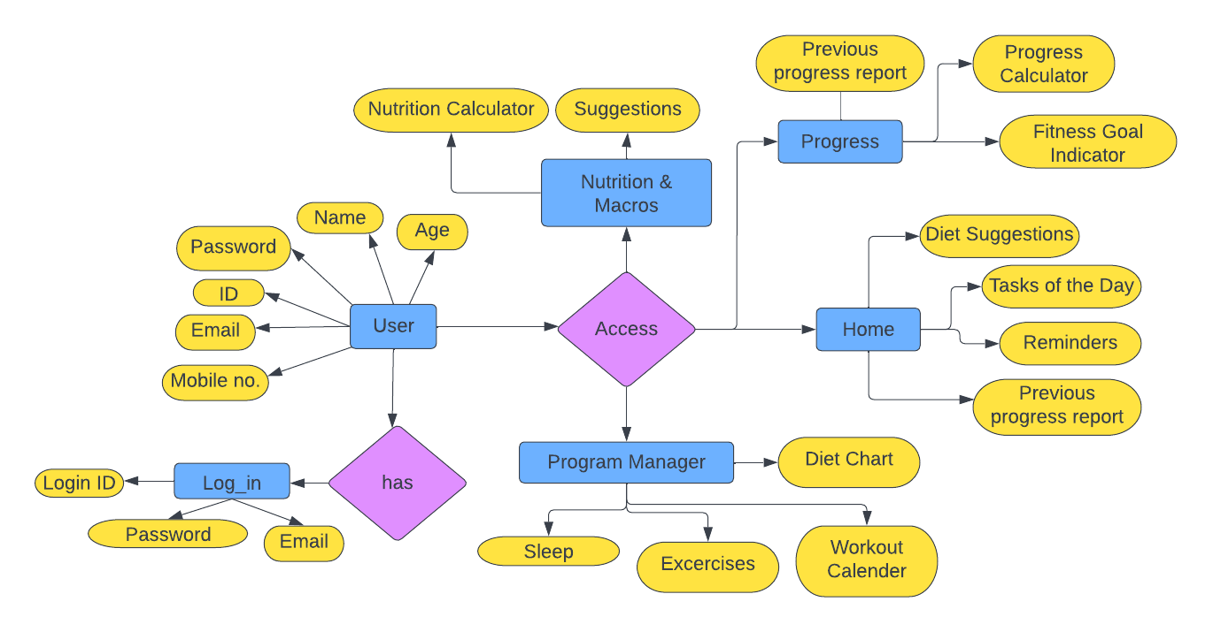
Projects Design
ER Diagram / Use Case Diagram:

Slide 7
Project Progress
GANTT Chart
Estimated time to complete the project
Task No. | Task | Sep-Oct | Oct-Nov | Nov-Dec | Dec-Jan | Jan-Feb | Feb-Mar | Mar-Apr | Apr-May
1. | Requirement Analysis
2. | Design
3. | Coding
4. | Testing
5. | Implementation
6. | Documentation
7. | Final Review

Slide 8
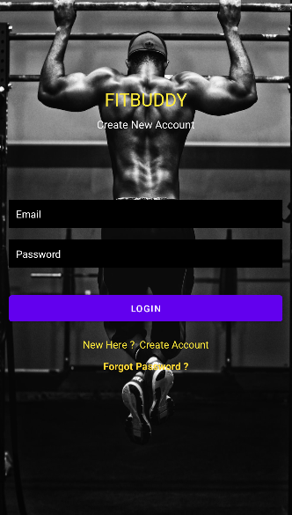
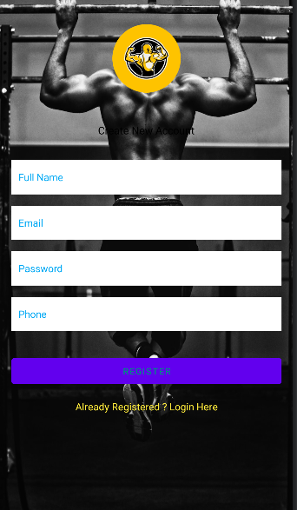
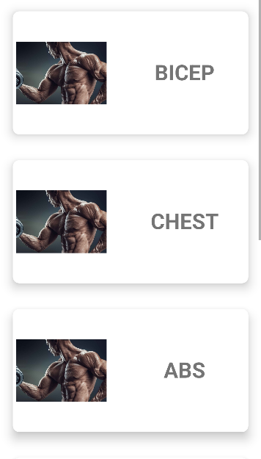
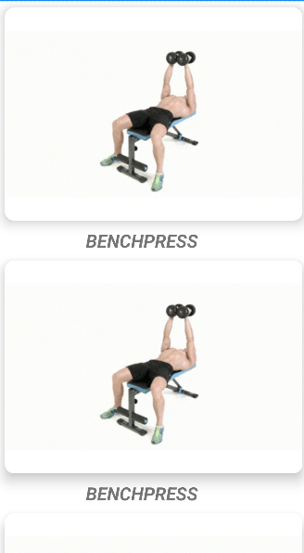
Project Screenshots

Slide 9
Future Scope
Include feature like “Local GYM Locator”.
Add shopping Section for Supplements.
Create a community to let users support each other.
Informative fitness related content that educates users in fitness community.
Introduce a blog section where users can write and share their experience.
Monetize app for users to earn as a side hustle income.

Slide 10
Conclusion
It’s a personal training application.
It’s a free platform for people who cannot afford personal trainer in their budget.
People who are travelling continuously and do not have time to go to gym, this application will provide training in their pockets.
It helps user’s to track how close or far they are from their fitness goals.

Slide 11
References
www.youtube.com
www.geeksforgeeks.com
www.tutorialpoint.com
www.javatpoint.com
www.mdndocs.com

Slide 12
THANK YOU

